Slide 1

Project 6: Automatic Registration in Classrooms
12 David Han, 15 Krish Gupta, 38 Jack Xiang

Slide 2
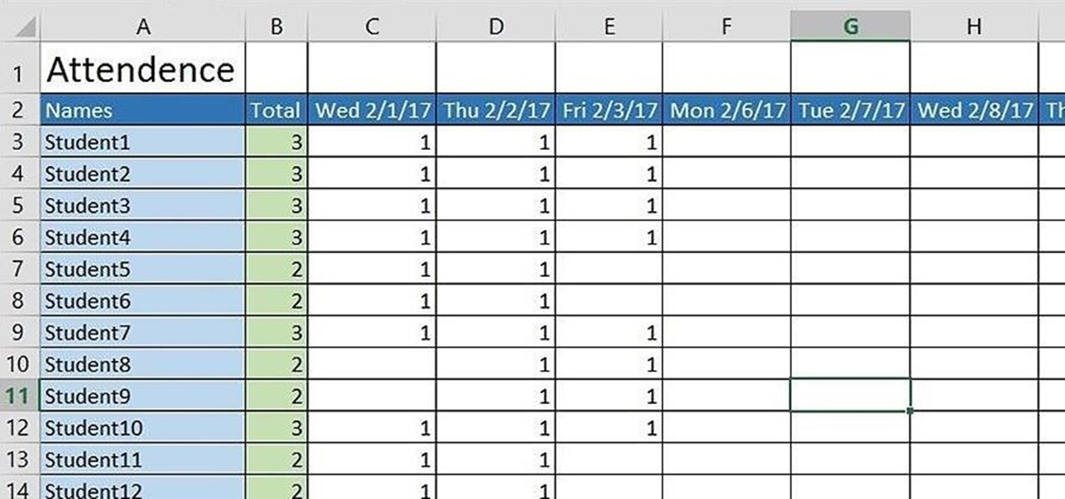
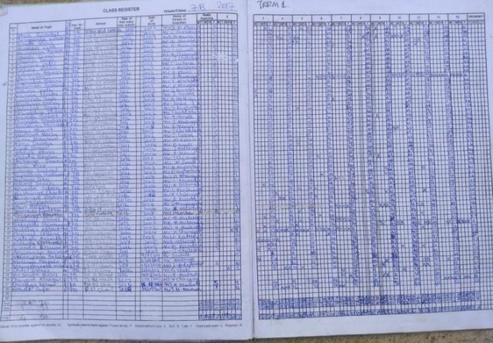
Background & Motivation
Classrooms + Traditional Attendance Methods
Time consuming + Sometimes teachers forget
This is the case for most schools (especially those that have paper attendance)
Notes:
David

Slide 3

Objectives
Streamline attendance taking process within classes
Ensure a high level of accuracy
Notes:
David

Slide 4
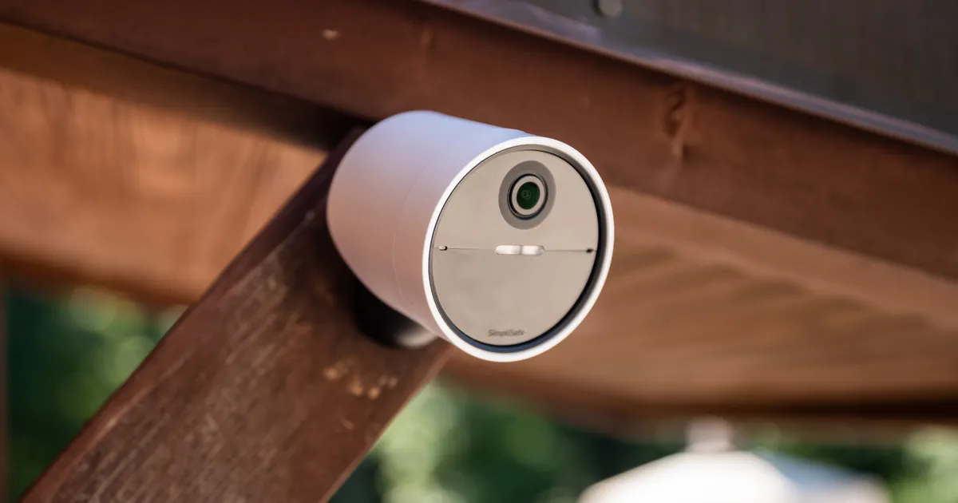
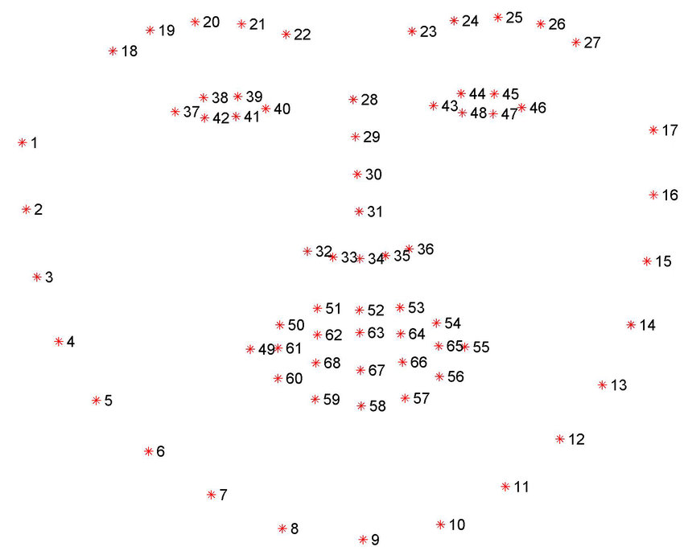
Our Solution
We can use facial recognition, placing a camera at the door of every classroom, to automatically recognise and register students.
Notes:
Address the way it would work
Jack

Slide 5
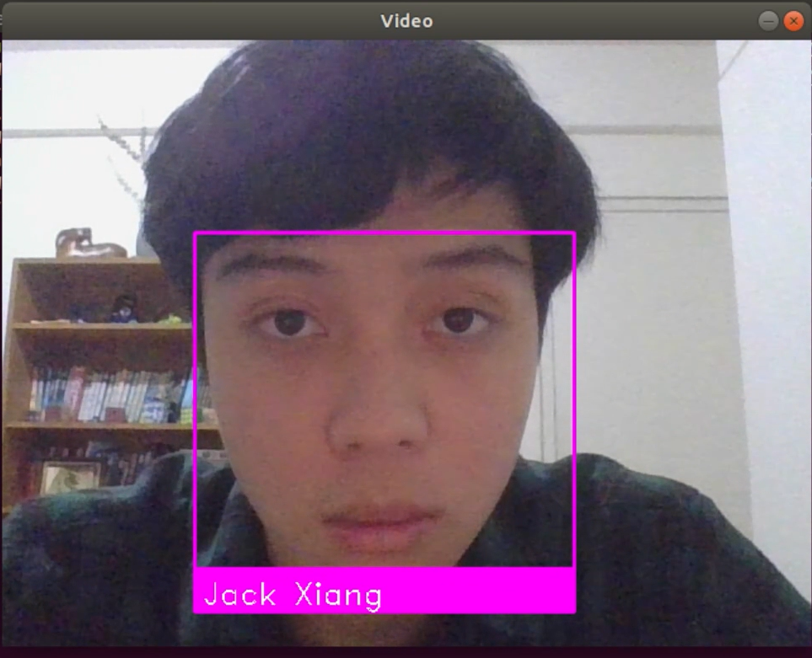
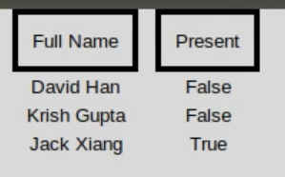
How Does it Work?
Face-recognition library
Recognises face landmarks and compares to existing images of students
Output attendance list
Notes:
Krish

Slide 6



How accurate is it?
-
13/14
Correct
-
Good for detecting known faces
Bad when encountering unknown faces
Notes:
David

Slide 7

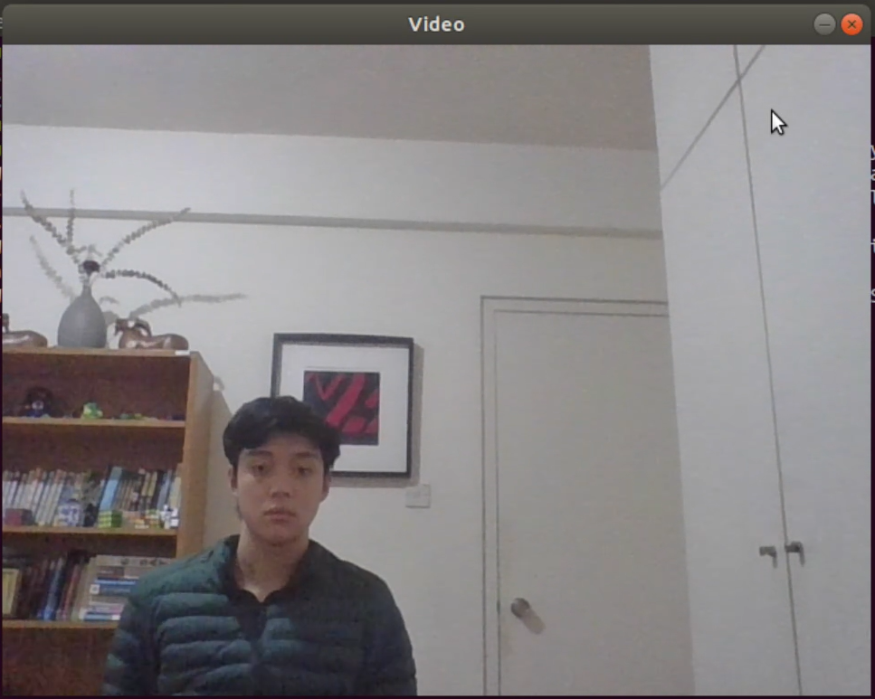

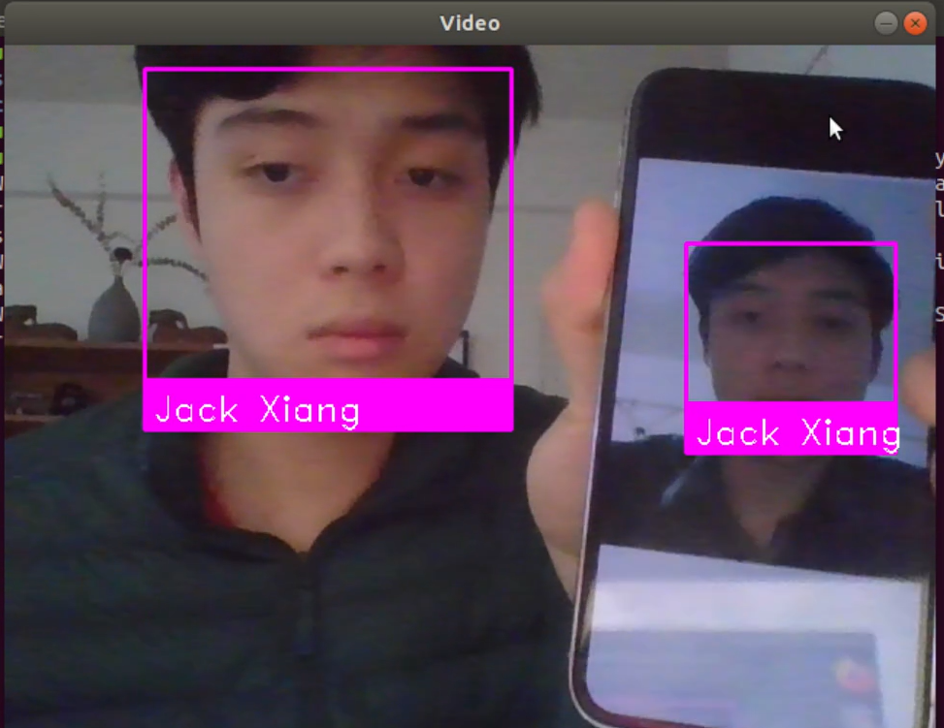
What are the limitations?
?
Don’t use my face!!
Notes:
Issues + Solutions
Privacy (within schools signing the agreements to allow for this software)
Efficiency with masks (relying on mask mandate to be removed for accuracy to significantly improve)
Multiple people entering (Semantic Segmentation)
Weird angles (may have to ask people to look up, habit that will develop over time)
Anti Face Spoofing (solution = better camera or including in code, EAR ratio blip or smth)
Jack

Slide 8
Reflection on the Project
Familiarised more with Jupyter, Linux OS, GitHub
Very glad to test our project on our class at school
Understanding that solving a real-world problem is not easy!
Notes:
Krish

Slide 9
Thank You!

